Slide 1
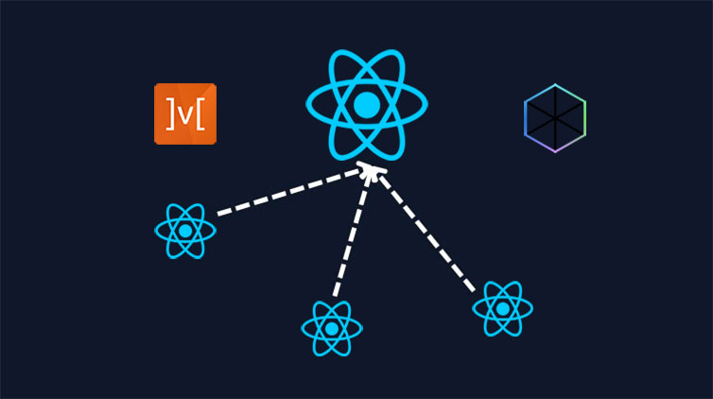
React Monorepo: Real World App with Fluent UI, MobX & More

Slide 2
In this tutorial, we will cover the following topics:
Setting up the project environment.
Creating React Monorepo Applications
Exploring the features of the Task Manager application, including:
Task listing
Task creation
Task editing
Task deletion
Creating React Libraries.
Managing state effectively with MobX.
Integrating APIs
Integrating Fluent UI to create a polished user interface.
Implementing end-to-end and unit testing using Cypress and Vitest.
Deployment of the application using Vite.
Conclusions

Slide 3
Directory Structure
└─ react-monorepo
├─ ...
├─ apps
├─ libs
│ ├─ task-manager
│ │ ├─ components
│ │ │ ├─ ...
│ │ ├─ core
│ │ │ ├─ ...
│ │ ├─ models
│ │ │ ├─ ...
│ └─ shared
│ └─ ui
│ ├─ ...
├─ ...

Slide 4
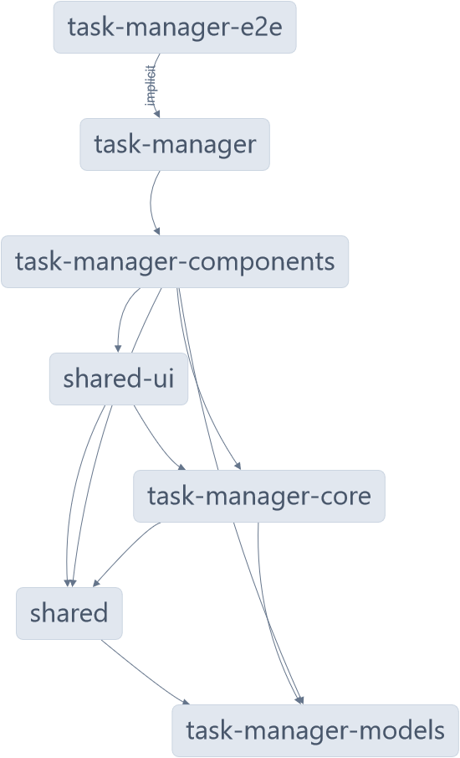
Visualizing Task Manager Project Structure

Slide 5
What is Nx?
Nx is a toolkit for monorepo development, primarily focused on Angular, React, Nest.js, etc.
Features of NX Workspace
It organizes projects within a monorepo in a structured manner.
It provides dedicated directories for applications, libraries, and shared code, thus promoting code reuse, modularity, and maintainability.
With a monorepo-style NX workspace, you can easily add new projects, refactor existing ones, and manage the entire codebase as a cohesive unit.

